Slide 1
Welcome To Our Presentation

Slide 2

PRESENTATION OF PUBLIC HEALTH Group-C NAME ID 1. FARZANA AKTER 1711386630 2. MD. ABDULLAH AL MAHMUD 1712349630 3. AZIZUL HAKIM TAREQ 1711080642 4. MAHIZEBIN SHAMS-E-MOFIZ 1712634642 5. SUJON MAJUMDER 1712846630 6. Z.M.ZULKARNINE 1712457630

Slide 3
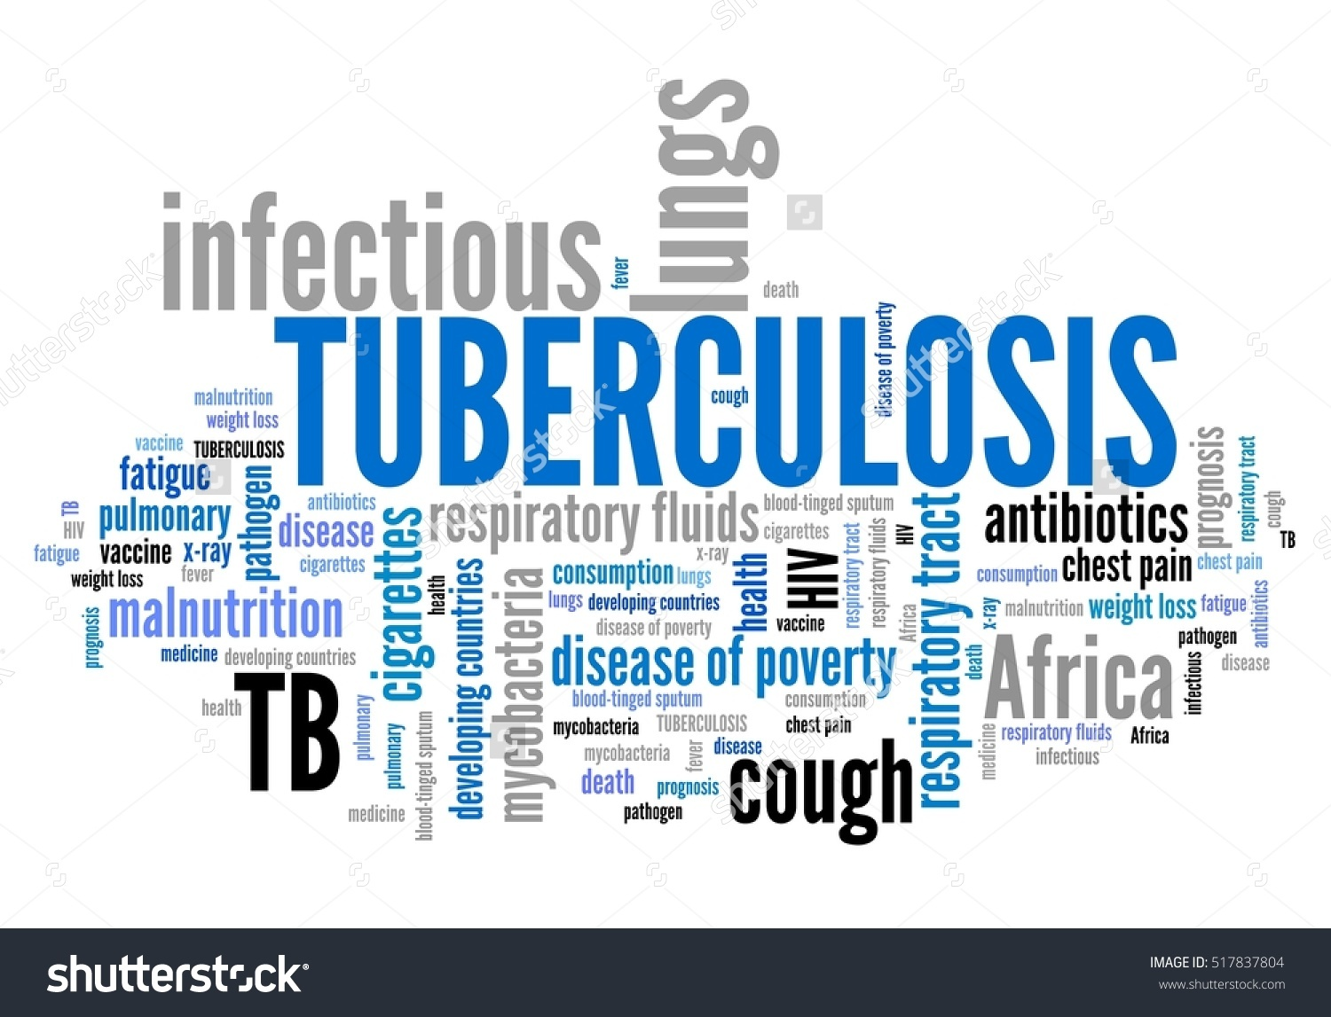
Tuberculosis
a deadly yet curable disease

Slide 4
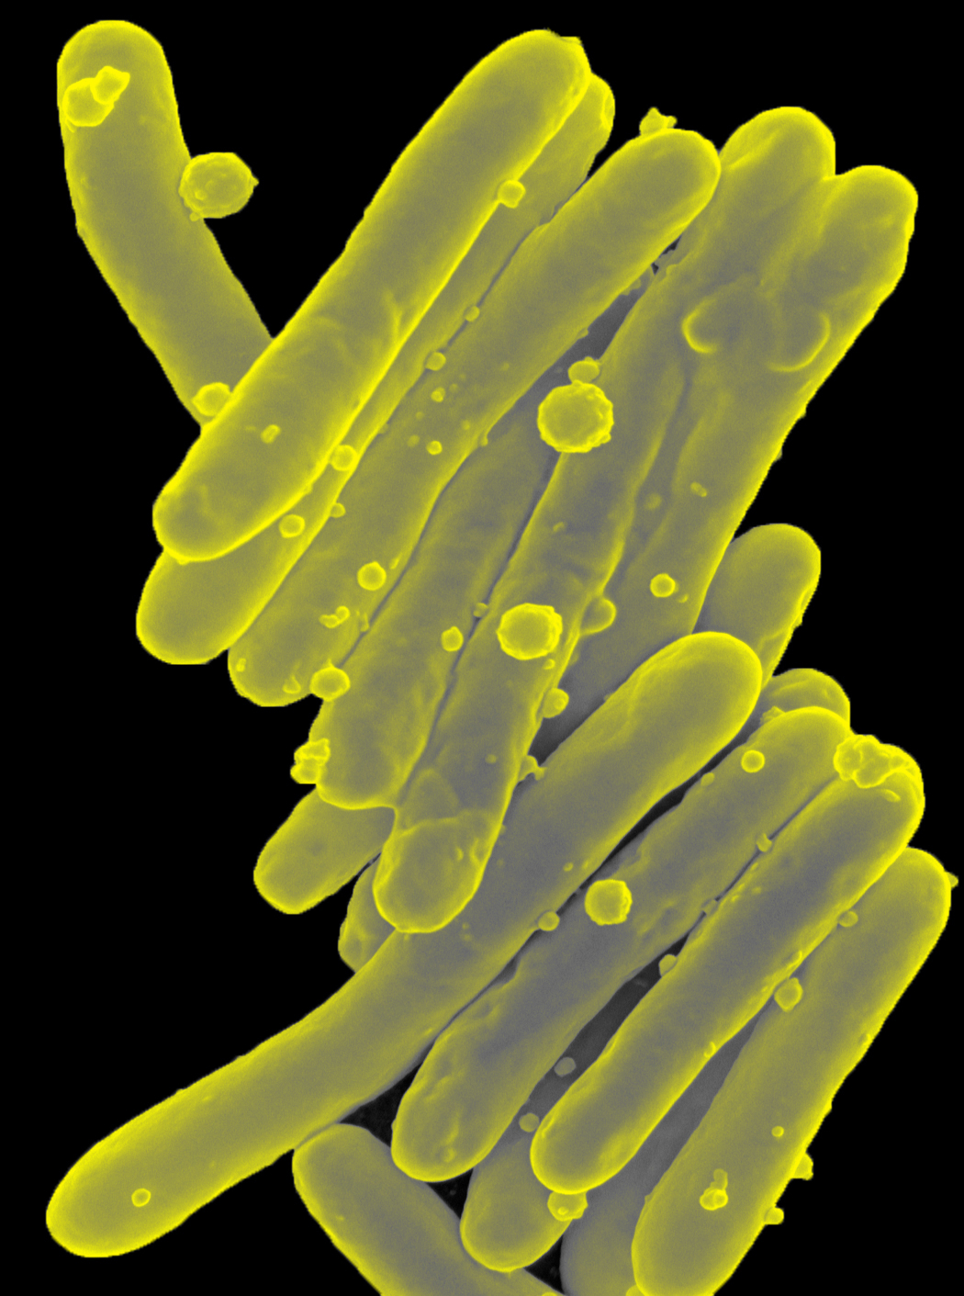
Introduction:- Tuberculosis or TB its commonly called , TB is a bacteria disease which in humans is usually caused by an organism called Mycobacterium tuberculosis TB infection spread through inhaling tiny droplets from the caughs or sneezes of an infected person , the bacteria released into the air . Typically , its attacks the lungs and also other parts of the body like-kidney,spine,brains
Microscopic image of a long, thin, rod-like bacteria. Colorized scanning electron micrograph of Mycobacterium tuberculosis.

Slide 5
Tuberculosis is the second biggest killer globally . In 2015 1.1 million people died cause of having TB.

Slide 6
Types of tuberculosis
there are two types of tuberculosis infection
Latent :-
in latent, the bacterium that causes tb, remains in the body in an
inactive state. They cause no symptoms and are contagious. Further,
they can become active.
Active :-
In some people, tb bacteria destroys the immune systems defenses
and begin to multiply, resulting in the progression from latent tb
infection to tb diseases.

Slide 7



SYMPTOMS
Coughing sometimes with mucus or blood
Fever
Fatigue

Slide 8
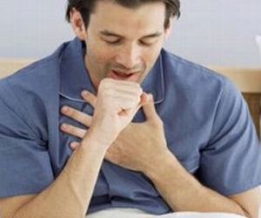
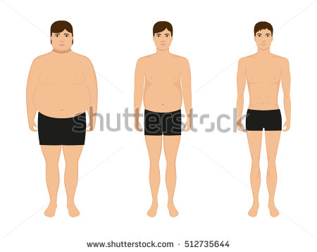
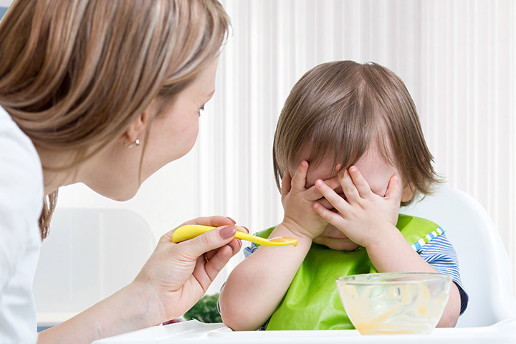

SYMPTOMS
Chest pain, or pain with breathing & coughing
Loss of weight
Lose of appetite
Night sweats

Slide 9


Hello! I’m a public health officer
Case briefing :
Hello!! I’m a public health officer
vaccination
HIV prevention
Breastfeeding tips
TB treatment and follow up

Slide 10
TREATMENT OF TUBERCULOSIS
Treatment of TB takes six to nine months and sometimes longer. TB can be cured in almost all cases by taking the medication as prescribed by your doctor for the full course of treatment (At least six month)
Multi-drug treatment is employed to treat active TB disease. Depending on state or local public health regulations, you may be asked to take your antibiotics under the supervision of your physician or other healthcare professional. This program is called “Directly Observed Therapy”.
Designed to prevent abandonment or erratic treatment, which may result in “failure” with continued risk of transmission or acquired resistance of the bacteria to the medications, including the infamous multi-drug resistance TB (MDR-TB).

Slide 11
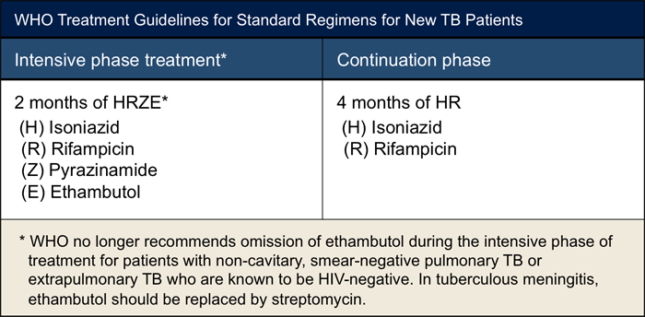
MOST COMMON DRUGS FOR TB

Slide 12
Completing treatment is essential
After a few weeks, you won’t be contagious and you may start to feel better. It might be tempting to stop taking your TB drugs. But it is crucial that you finish the full course of therapy and take the medication exactly as prescribed by your doctor.

Slide 13
IDENTIFIED PROBLEMS
Male dominating society
Lack of knowledge
Lack of social awareness
Superstitions in the community

Slide 14
PROPOSED SOLUTION
Social awareness
Increasing literacy rate
Reducing Male Dominance
Empowering and motivating all to take free TB service

Slide 15
Social Awareness
R
advertising on different media
Arranging seminar
Woman education
Adding more volunteers

Slide 16
ENCOURAGING STUDENTS AND THEIR PARENTS
DEPENDENCE OF HEALTH ON EDUCATION
RENOWNED PERSONS LIKE CELEBRATIES AND POLITICIANS SHOULD HOLD SEMINARS WITH GENERAL PEOPLE
GOVERNMENT SHOULD TAKE STEPS
Improving Literacy Rate

Slide 17
ENCOURAGEMENT (to go to treatment)
FREE TREATMENT
REMOVE SUPERSTITIONS
MOTIVATE WOMEN
EXPERT DOCTORS

Slide 18
Male dominance
CHANGING MENTALITY
IMPOVE MATURITY
OPEN MINDEDNESS
IMPROVING LITERACY RATE

Slide 19
Current Situation in Bangladesh
r
The South-East Asia region accounts for a disproportionately high number of global TB cases and Bangladesh is one of 22 ‘high TB-burden’ countries.
WHO has set a target for a 95% reduction in deaths and a 90% reduction in TB incidence by 2035.
A treatment success rate of 93% has been achieved among all new and relapsed cases.
Bangladesh faces challenges in achieving universal access to TB prevention and care services because of poor access to good quality diagnostic services

Slide 20
THANK YOU

